Slide 1

PREDICTING COUNTRY’S
LIFE EXPECTANCY
MACHINE LEARNING PROJECT
BY: Dishank & Dharmendra

Slide 2
AGENDA
1. Introduction
2. Problem statement
3. Objective
4. About dataset
5. Overview
6. Algorithm
7. Dashboard with PowerBI
8. Performance of models
9. Web development

Slide 3
INTRODUCTION
Life expectancy is a statistical measure of the average time a human being is expected to live. Life expectancy varies by geographical area and by era.
In the Bronze age, for example, life expectancy was 26 years, while in 2010, it was 67 years.
Life expectancy of a country depends on various factors: Regional variations, Economic Circumstances, Sex Differences, Mental Illnesses, Physical Illnesses, Education, Year , GDP, alcohol intake of people in the country, expenditure on healthcare system, some specific disease related deaths that happened in the country and other demographic factors
However, as life expectancy is calculated based on averages, a person may live for many years more or less than expected.

Slide 4
PROBLEM STATEMENT
Although there have been lot of studies undertaken in the past on factors affecting life expectancy considering demographic variables, income composition and mortality rates. It was found that affect of immunization and human development index was not taken into account in the past. Also, some of the past research was done considering linear regression based on data set of one year for all the countries. Hence, this gives motivation to resolve both the factors stated previously by formulating a regression model based on linear regression while considering data from a period of 2000 to 2015 for all the countries.
Important immunization like Hepatitis B, Polio and Diphtheria will also be considered. In a nutshell, this study will focus on immunization factors, mortality factors, economic factors, social factors and other health related factors as well. Since the observations this dataset are based on different countries, it will be easier for a country to determine the predicting factor which is contributing to lower value of life expectancy. This will help in suggesting a country which area should be given importance in order to efficiently improve the life expectancy of its population.

Slide 5
OBJECTIVE
The Objective of this Project is to built a model which can predict the life expectancy of a country according to past statistical data of the country.
This Project includes:
1. Analysis of the Expectancy Dataset.
2. Applying Regression models to the data.
3.Visualisation using power BI
4. Web deployment on web application

Slide 6
ABOUT DATASET
The Global Health Observatory (GHO) data repository under World Health Organization (WHO) keeps track of the health status as well as many other related factors for all countries.
In order to predict the life expectancy of a country there are various independent variables are considered like status of country (developing or developed), different diseases affecting human health.
In the given dataset there are 21 factors available that affect the life expectancy of a country. Few factors like Infant death, Adult mortality, Alcohol, Percentage of Expenditure, BMI, etc are considered
The dataset related to life expectancy, health factors for 193 countries has been collected from the same WHO data repository website and its corresponding economic data was collected from United Nation website.

Slide 7

It has been observed that in the past 15 years , there has been a huge development in health sector resulting in improvement of human mortality rates especially in the developing nations in comparison to the past 30 years.
In this project data is considered from year 2000-2015. The individual data files have been merged together into a single dataset. The result indicated that most of the missing data was for population, Hepatitis B and GDP.
The final merged file consists of 22 Columns and 2938 rows which meant 20 predicting variables.
This dataset is obtained from Kaggle.com as it a reliable website for datasets.

Slide 8
OVERVIEW
The language used for exploratory data analysis , pre-processing, feature selection, model development and model deployment is Python. Which is widely known and acceptable language for data science.
IDE Used is Jupyter Notebook.
Visualisation tool used is Power-BI
There are various libraries in python which were used like :
Scikit-learn which is most useful library for machine learning in Python. The sklearn library contains a lot of efficient tools for machine learning.
Matplotlib and Seaborn are yet another libraries used for creating static, animated and interactive visualizations.
Numpy stands for 'Numerical Python’ which is used for mathematical and logical operations on arrays .
Pandas library for reading file, working with data frames and for other analysis purposes.
Streamlit and Pickle for making web application.

Slide 9
ALGOTHIMS
Supervised Machine learning is the kind of predictive analysis that investigates the relationship between the dependent variable and independent variable/s. Regression is part of supervised machine learning where output variable is a real or continuous value, such as age, weight variables or any numerical value.
Different regression models differ based on the kind of relationship between dependent and independent variables, they are considering and the number of independent variables being used. So, performance varies from model to model.
The regression algorithms used in this dataset are as follows:
1) Linear Regression
2) Decision Tree Regressor
3) Random Forest Regressor
4) ADABOOST
5) XGBOOST
6) K-Nearest Neighbour Algorithm
7) Support Vector Machine Algorithm

Slide 10
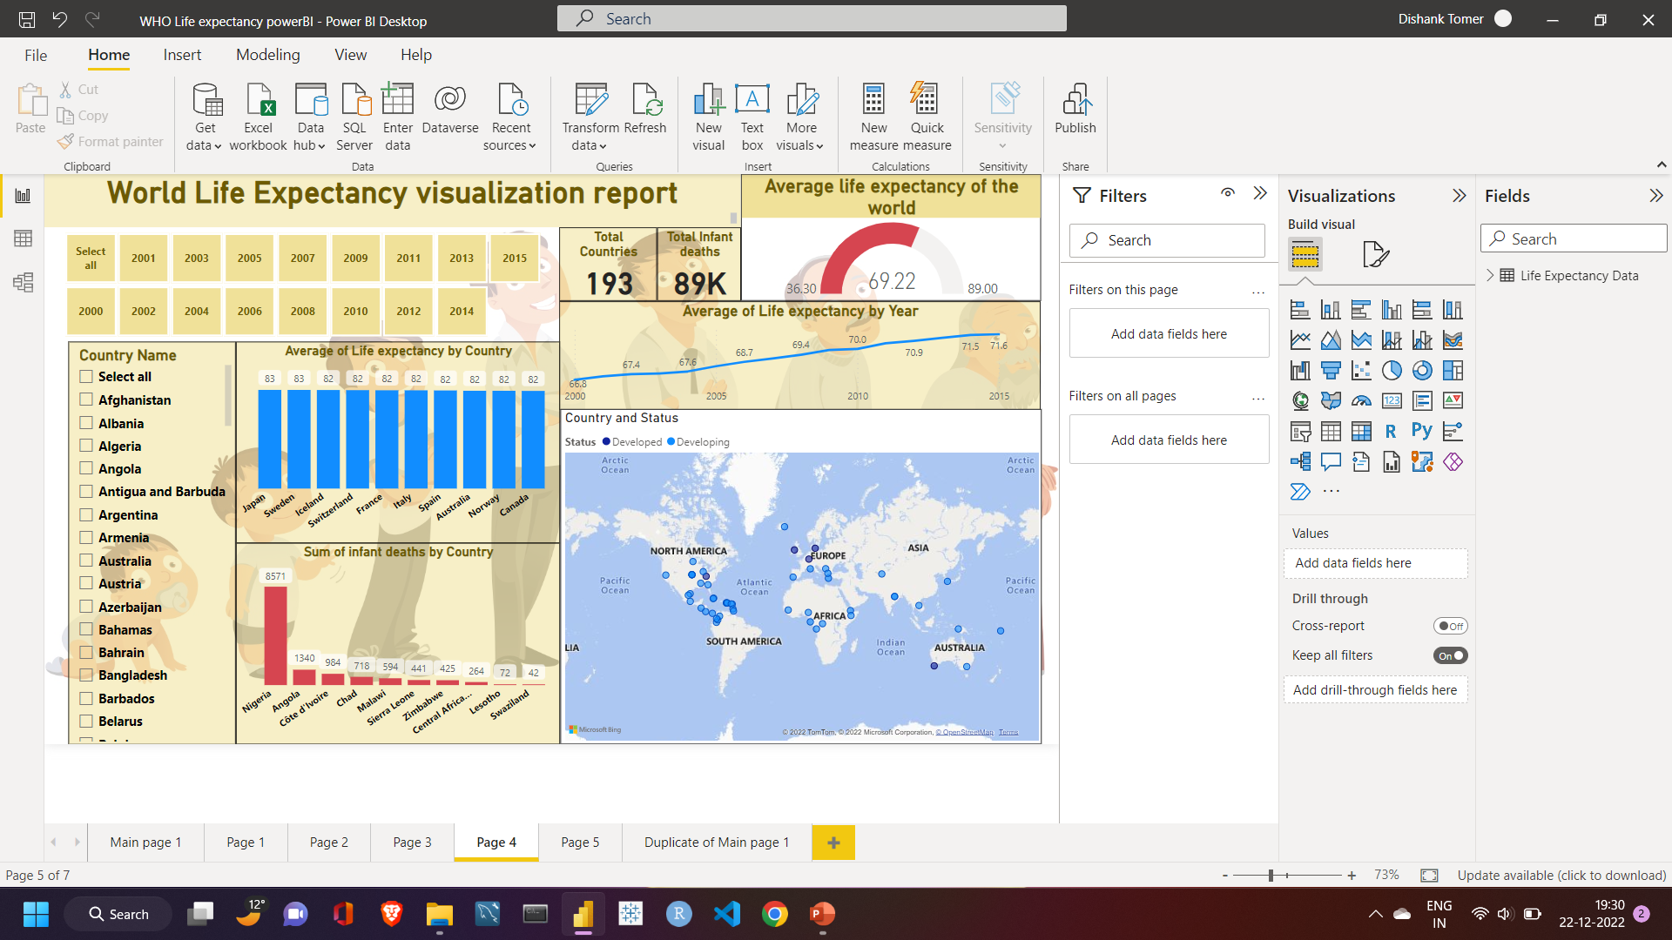
DASHBOARD IN POWER BI
It’s a dashboard made using PowerBI in which the user can select year and the country according to which the data will be filtered like the total infant deaths in a country during a year. With the help of map one can see the Country's’ geographical map related to the country chosen by the user.

Slide 11
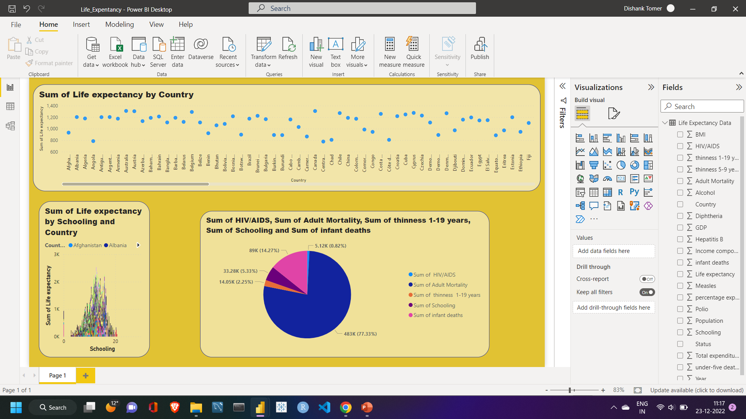
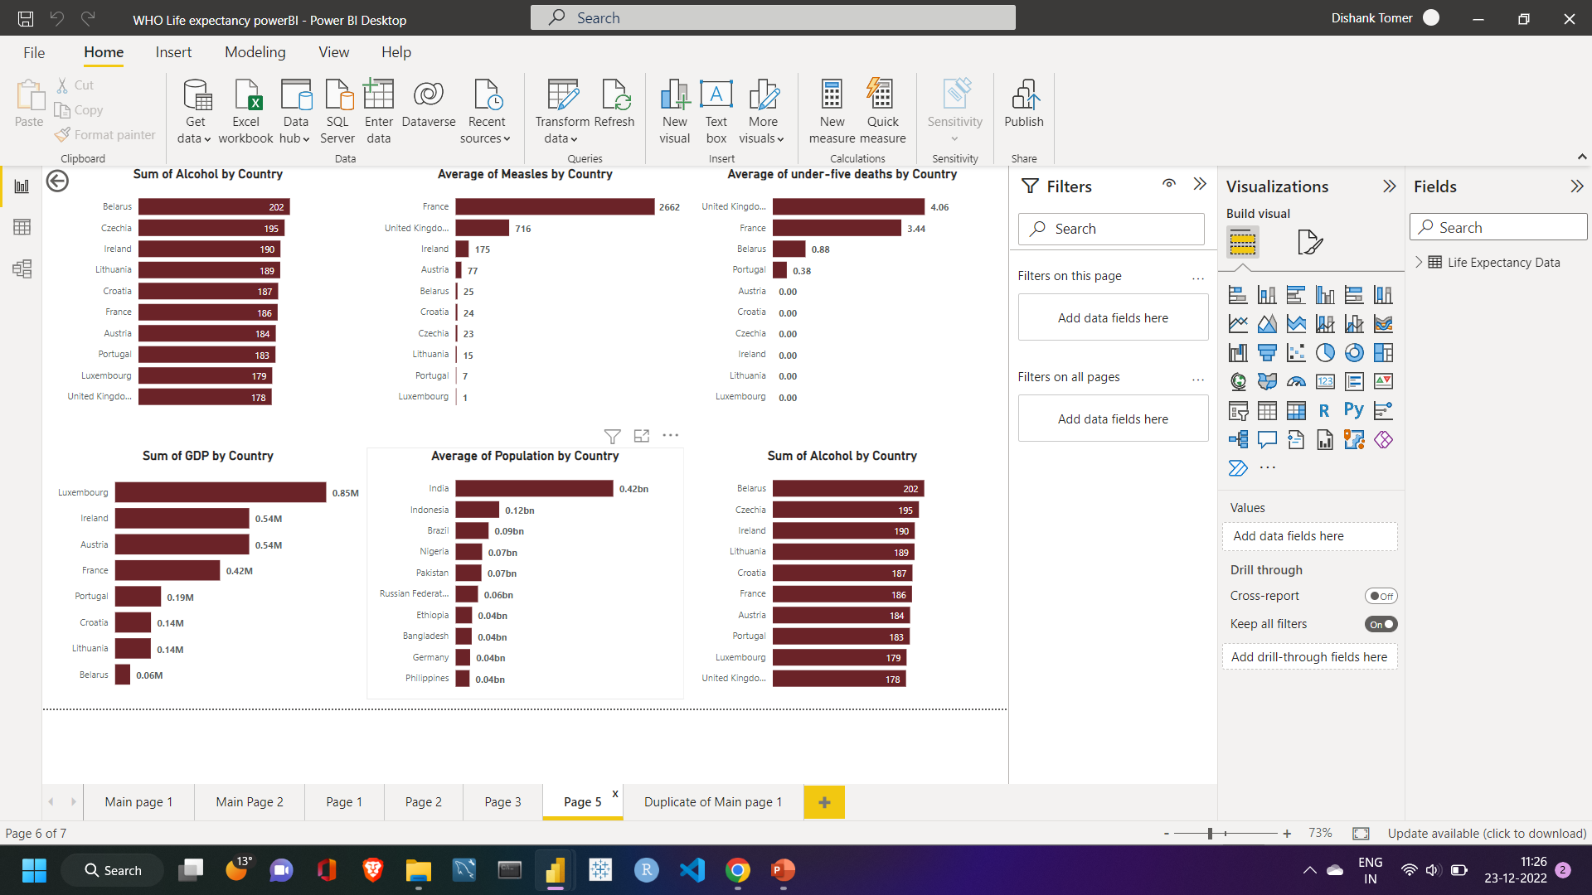
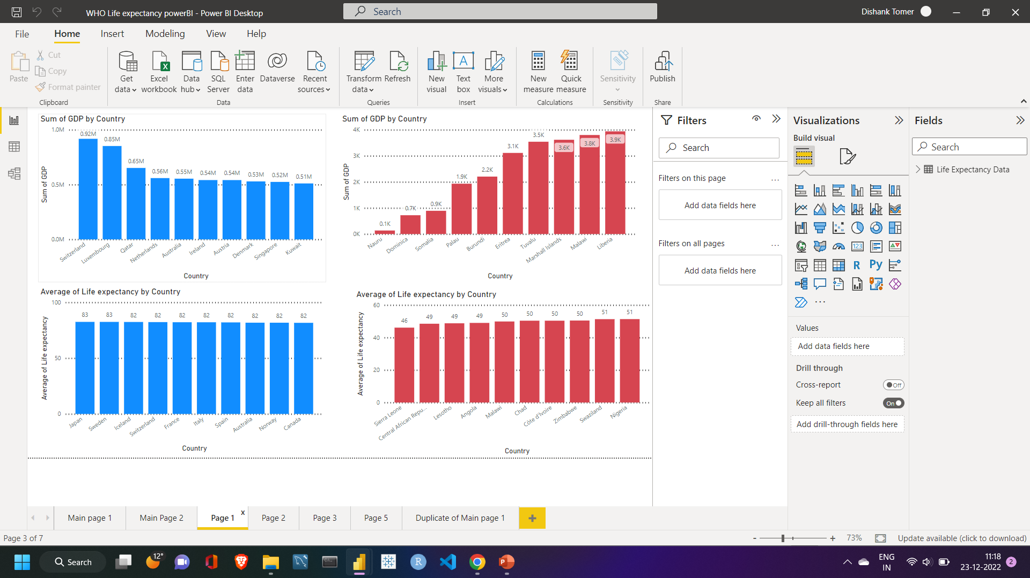
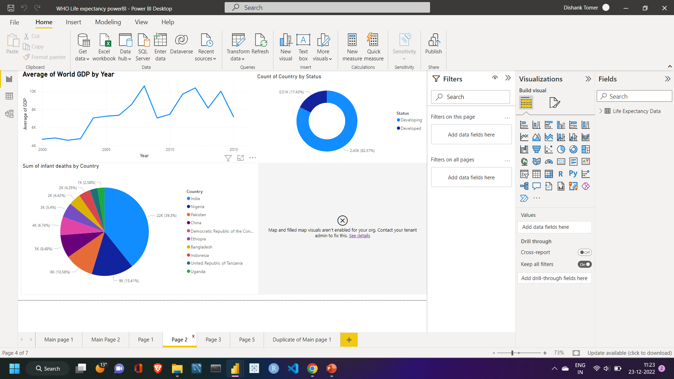
DASHBOARD IN POWER BI

Slide 12
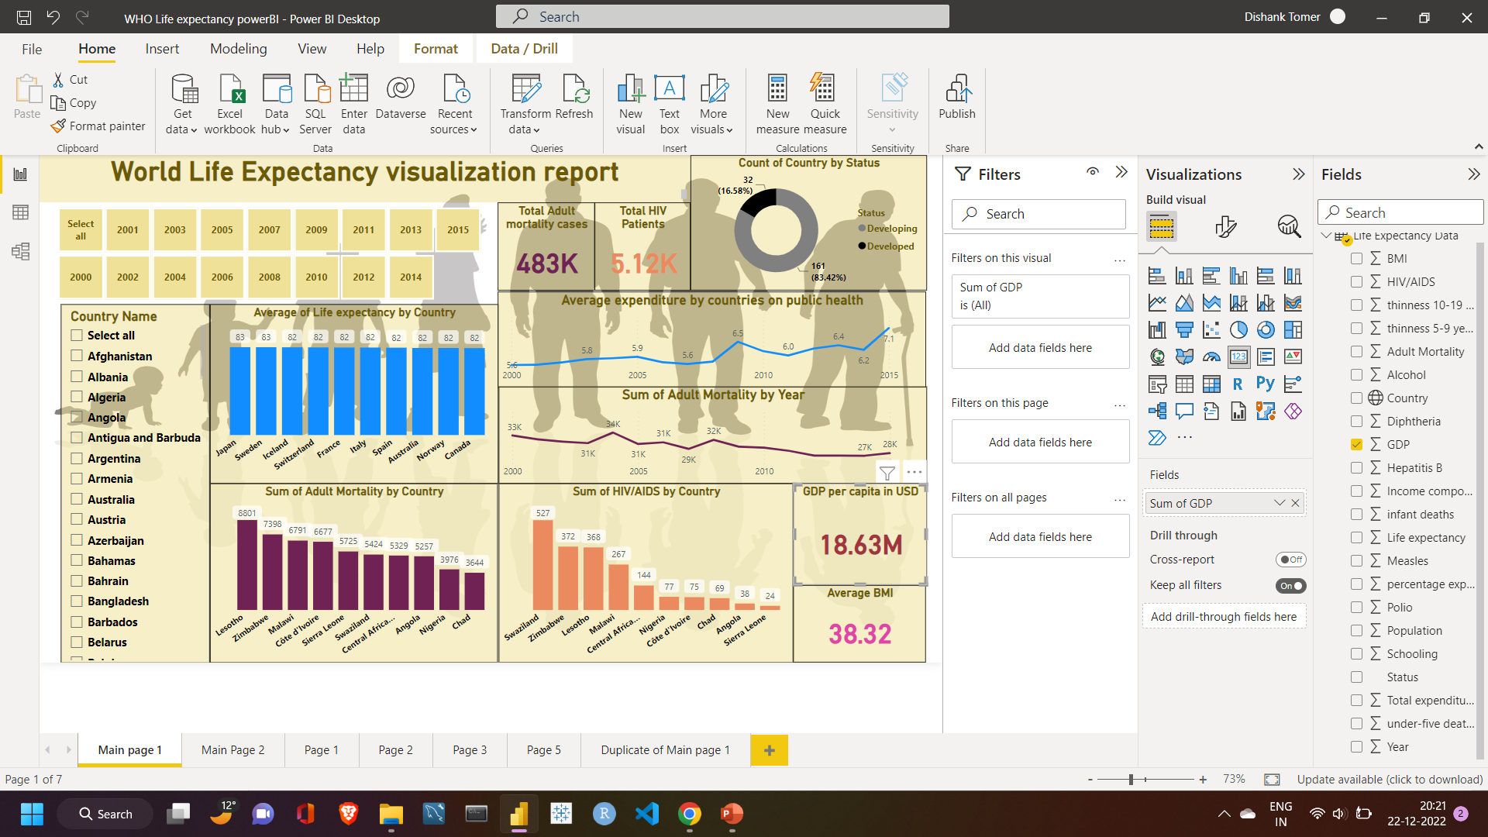
DASHBOARD IN POWER BI
We observed there is a negative relation between adult deaths and healthcare expenditure done by government around the world. Year by year adult deaths are decreasing as the countries increases their spending on public health . GDP plays a vital role for countries in spending on public health. We can analyze that user can observe total cases of adult mortality and HIV cases in one or more countries. The data we have has more countries of developing nation with comparison to developed nations.

Slide 13
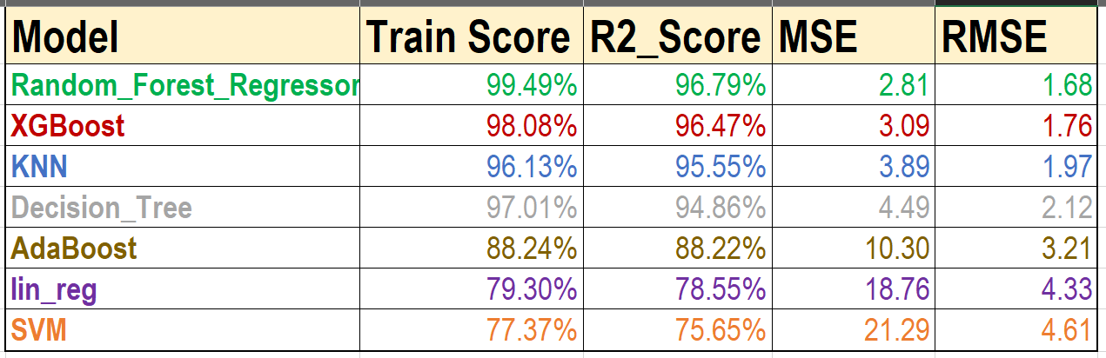
PERFORMANCE OF MODELS
Key observations:
With Train_score, R2_Score, MSE and RMSE we can observe the best performing algorithm was Random forest regressor, followed by XgBoost, then KNN, then Decision Tree, then AdaBoost, then linear regression and in the last Support vector machine.

Slide 14
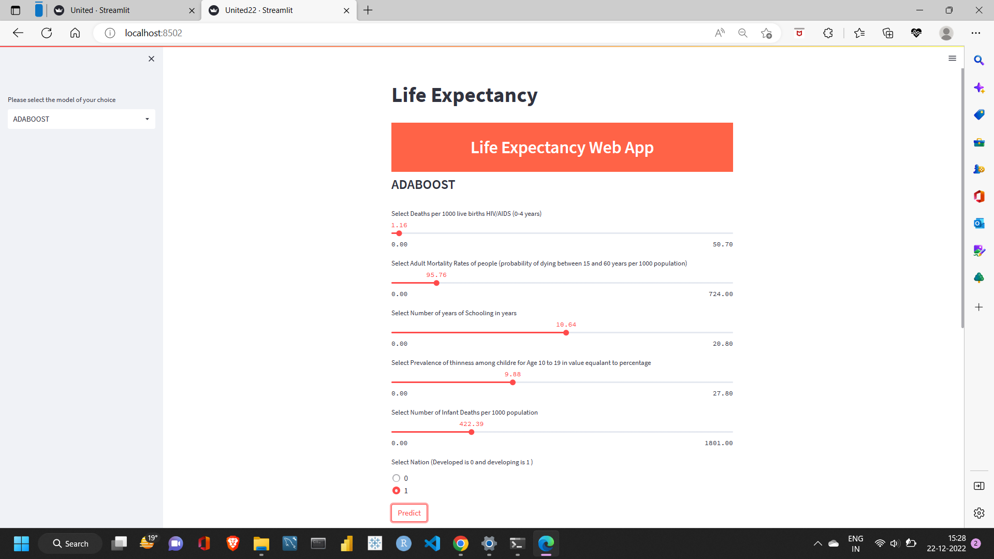

WEB DEPLOYEMENT
Key notes:
This is a web application made using streamlit which is famous library in Python programing language used for making web apps. User can input feature and algorithm oh his choice and it will predict the life expectancy of a country.

Slide 15


